Slide 1

INTELLERA: A Hardware Based Accelerated Matrix MAC Processor
Team Members:
2020414 Saad Khan (Team Lead)
2020487 Syed Zaeem Shakir
2020217 Mahnoor Maleeka
Supervisor: Dr Fahad Bin Muslim Co-supervisor: Dr Taj Muhammad
Co-supervisor: Dr Waqar Ahmed
Industrial Consultant: Dr. Kashif Inayat
Faculty of Computer Sciences and Engineering Ghulam Ishaq Khan Institute of Engineering Sciences and Technology, Pakistan
Notes:
1

Slide 2
Evaluation Criteria
PLO 3 | Design/Development of Solutions
PLO 5 | Modern Tool Usage
PLO10 | Communication
PLO11 | Project Management
Rubrics | PLO3 | PLO5 | PLO10 | PLO11 | Marks
Poster Design |  |  | ✓ |  | 5
Requirements mapped to the prototype | ✓ |  |  |  | 10
Solution development using modern IT tools/techniques |  | ✓ |  |  | 10
Progress Tracking according to promised deliverables |  |  |  | ✓ | 5

Slide 3
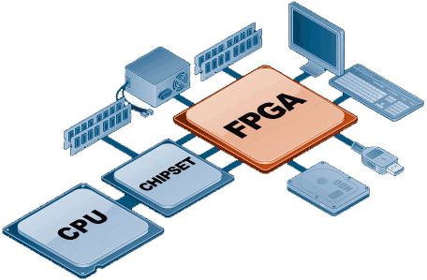
Recap
Problem Statement:
RISC-V Processor on FPGA
Power-Efficient Hardware Design
Matrix MAC Operations
Significance:
Innovation
High-Performance Computing
Benefits:
Speed
Efficiency
Breakthroughs

Slide 4

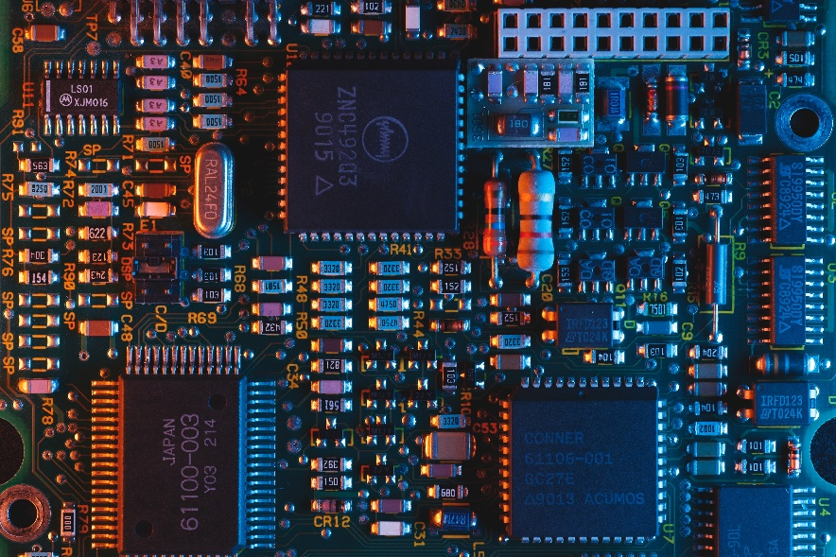
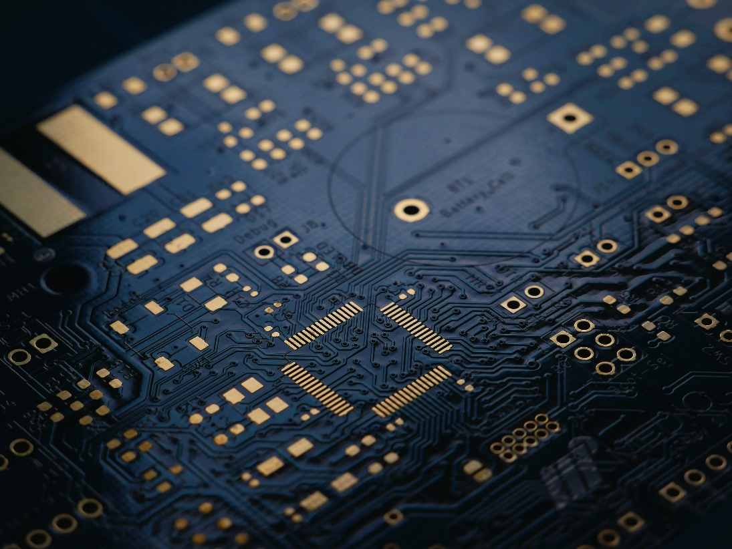
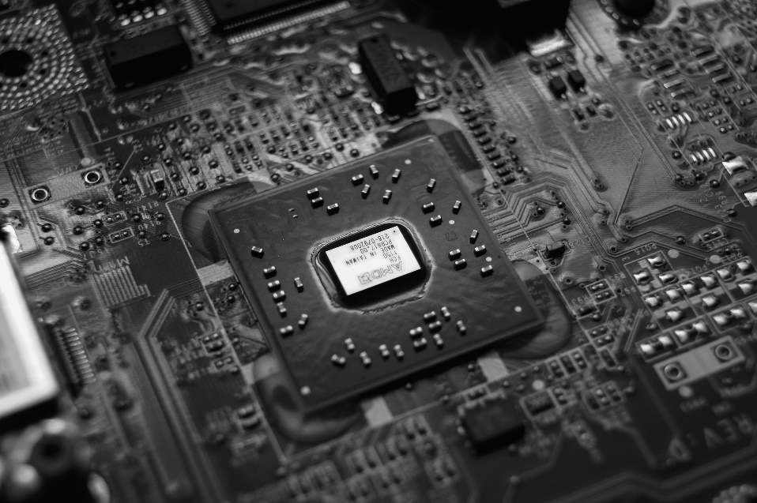
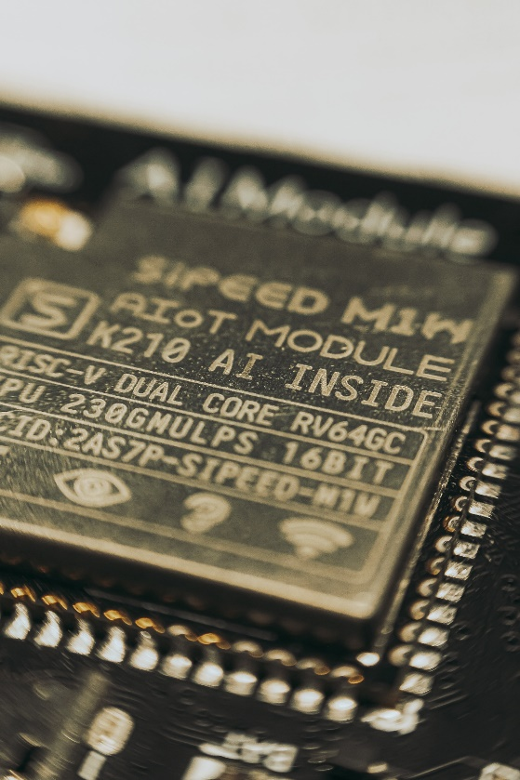
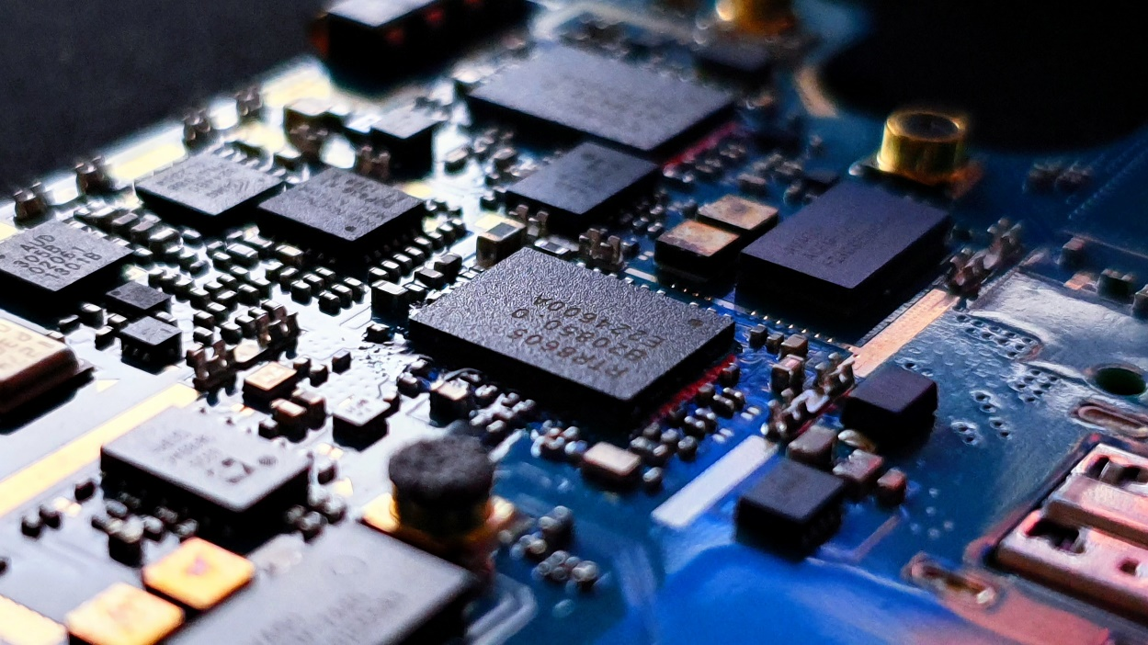
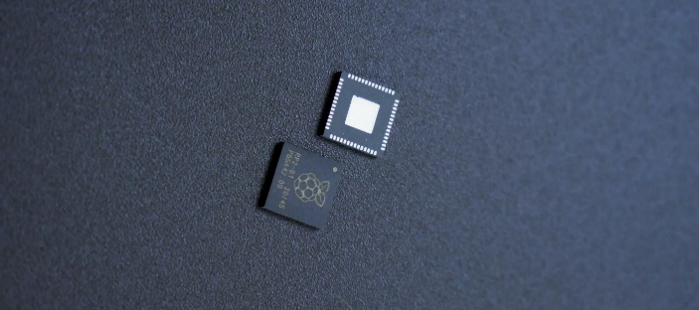
INTELLERA

Slide 5


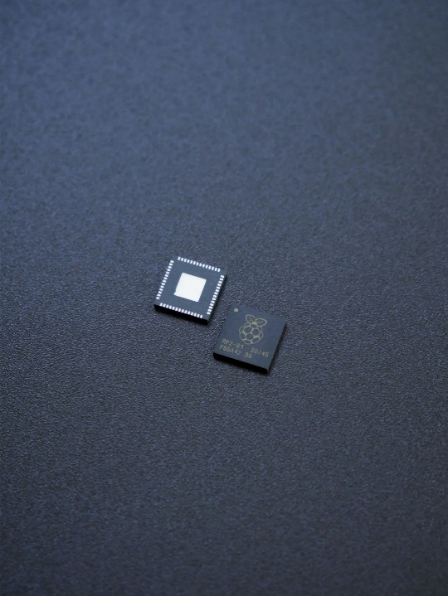


Rubric 4: Progress Tracking
Project Management Tools:
INTELLERA

Slide 6

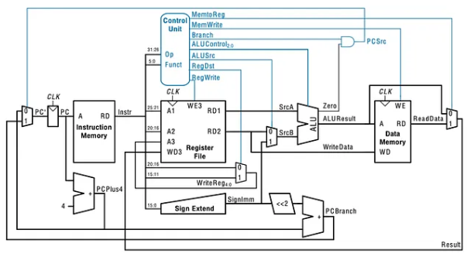
Rubric 2: Requirements mapping
Single Cycle Processor
Sep 2023 – Oct 2023
Features:
Low Power Consumption
Low Hardware Complexity
Single-Clock Instruction Execution
Predictable Timing
20+ executable Instructions
INTELLERA
Notes:
We Modified the ALU added some more instructions to it like branching, which lead to the modification of the control unit to accommodate these instructions. This processor is able to execute 17 unique Instructions

Slide 7


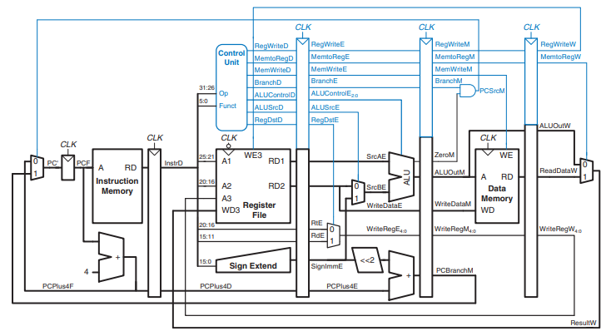
Rubric 2: Requirements mapping
5 Stage Pipelined Processor
Oct 2023 – Nov 2023
Features:
5 stage Pipelining
Increased Throughput
Efficient Resource Utilization
More Control
INTELLERA
Notes:
Here we incorporated 5 pipelines to our project which again required to modify our control unit significantly to accommodate these changes and so the processor or all the block are in sync with each other.

Slide 8

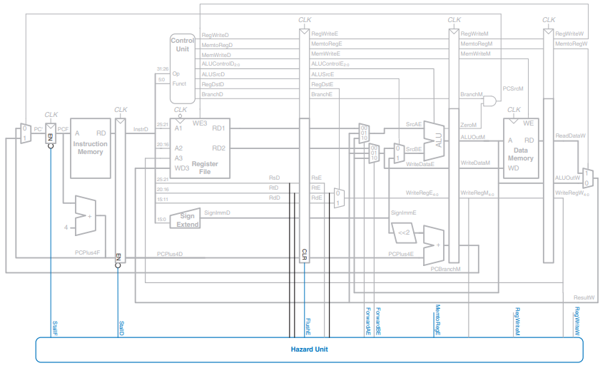
Rubric 2: Requirements mapping
5 Stage Pipelined Processor
With Hazard Control Unit
Nov 2023 – Dec 2023
Features:
Complete Hazard Control Unit
No Data Hazard
No Structure Hazard
No Branching Hazard
Only 1 Cycle for Flush
INTELLERA
Notes:
Now as we discussed in our previous presentation as well, there are 3 different types of hazards, Pipeline, Data and Branching hazards that can occur, majority of people either solve one or a combination of any 2 of these hazards whereas we were successful in resolving or controlling all 3 of them.

Slide 9

Rubric 2: Requirements mapping
5 Stage Pipelined Processor
With Matrix MAC
Dec 2023 – In Progress
MATRIX MAC
MAC_BUS
MACSrcD
MACSrcE
MACSrcM
Features:
Complete Matrix Mac Unit
Additional 6 Instructions for MAC
Separate Flash Memory
Parallel Data read/Write
Pipelining Support
INTELLERA
MACDME_D
MACDME_E
MACDME_M
MACA1_D
MACA1_M
MACA2_D
MACA2_M
Notes:
This is our main objective of this whole project, this is still under development and hopefully will complete soon. This will enable the processor to perform Matrix MAC operations while also adhering to the overall structure of the processor, like the pipelining , the control unit and the hazard unit all these 4 units will work in a rhythm with each other. Also this will enable us to execute 6 additional instructions on the processor, from loading the MAC memory to storing it back on to the ram plus executing the MAC instructions on this as well.

Slide 10

Rubric 2: Requirements mapped to the prototype
Feature Matrix, FR
Requirements | Previous Status
Custom ISA | Completed
Compatibility | Completed
Pipelining | Ongoing
Control Hazard | Not Started
FPGA Implementations | Not Started
Matrix MAC Instructions | Not Started
Testing & Verification | Ongoing
Current Status
75%
Improved
INTELLERA
Completed
Completed
Completed
Completed
Ongoing
Ongoing
Notes:
These were our features and Functional Requirements of our project that we discussed in our last presentation. And as you can see we have successfully achieved 75% of them and only 2 of 25% of them are remaing which will be completed soon.

Slide 11

Rubric 2: Requirements mapped to the prototype
FPGA Analysis
Parameters | Single Cycle Processor | 5 stage Pipelining with Control Unit | Processor with Matric MAC
Lookup Tables | 0.22% (89) | 0.45% (283) | N/A
Flip Flops | 0.01% (8) | 0.18% (223) | N/A
LUTRAM | 0.36% (48) | 0.36% (48) | N/A
DSP | 0% (0) | 1.25% (3) | N/A
Frequency | 322 MHz | 322 MHz | N/A
Power | 0.165 W | 0.132 W | N/A
INTELLERA
Board: NEXUS 4 DDR
Notes:
Lookup Tables: digital circuits that implement Boolean logic Flip Flops: store a single bit LUTRAM: Distributed RAM, basically Lookup tables in array or matrix form DSP: Digital Signal Processing unit.

Slide 12




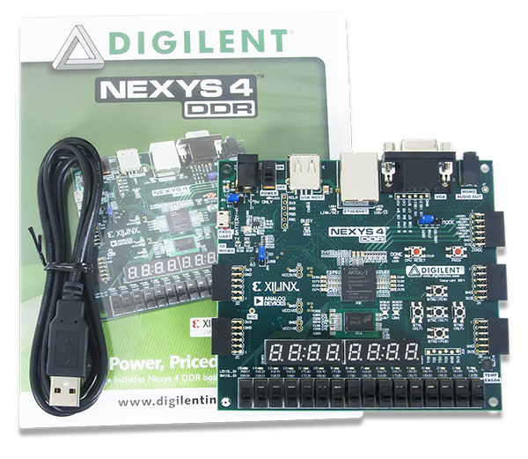

Rubric 3: Solution development using modern IT tools/techniques
Technologies Used
Sep 2023 – Oct 2023
INTELLERA

Slide 13
Rubric 1: Poster Design & Demo
Poster
Demo
INTELLERA

Slide 14
Rubric 1: Poster Design & Demo
ISA
ADD
SUB
MUL
AND
XOR
OR
SLT
LW
LI
ADDI
SLLI
SRLI
SW
BGE
BEQ
BNE
BLT
TEST INSTR’S
li x1, 300
li x2, 500
add x3, x1,x2
sub x4, x2,x3
MUL x5, x4,x2
Slli x6, x5,2
BNE x1,x2, Text
Text:
Addi x7,x0,1234

